Slide 1
Apna Bazaar
A Flea Market Explorer

Slide 2
Origin
All of us travel sometimes, don’t we ? And of course wherever we go we tend to explore the local market but the main problem is that we are not very familiar with the strange city.
Ahmedabad, like most places has a huge and varied market but the tourists and even locals are unfamiliar to this…
And so the idea dawned upon us to bring a solution to this problem through the means of Apna Bazar.

Slide 3
What is Apna Bazar ?
“ApnaBazaar” is a web application that helps the user to browse and explore among a varied collection of Flea market products as per their need.
The aim of the project is to develop a website application which helps the users to search and promote products and shops alike from the nooks and corners of the city and connect with shops that do not have enough exposure but have high quality and affordable products.

Slide 4
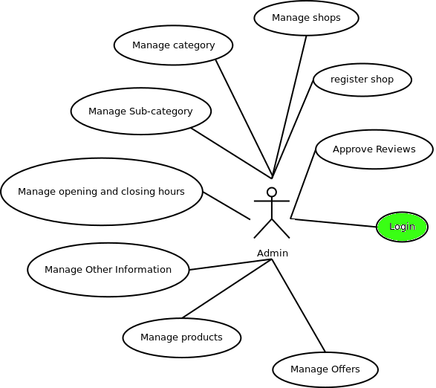
Admin Login

Slide 5
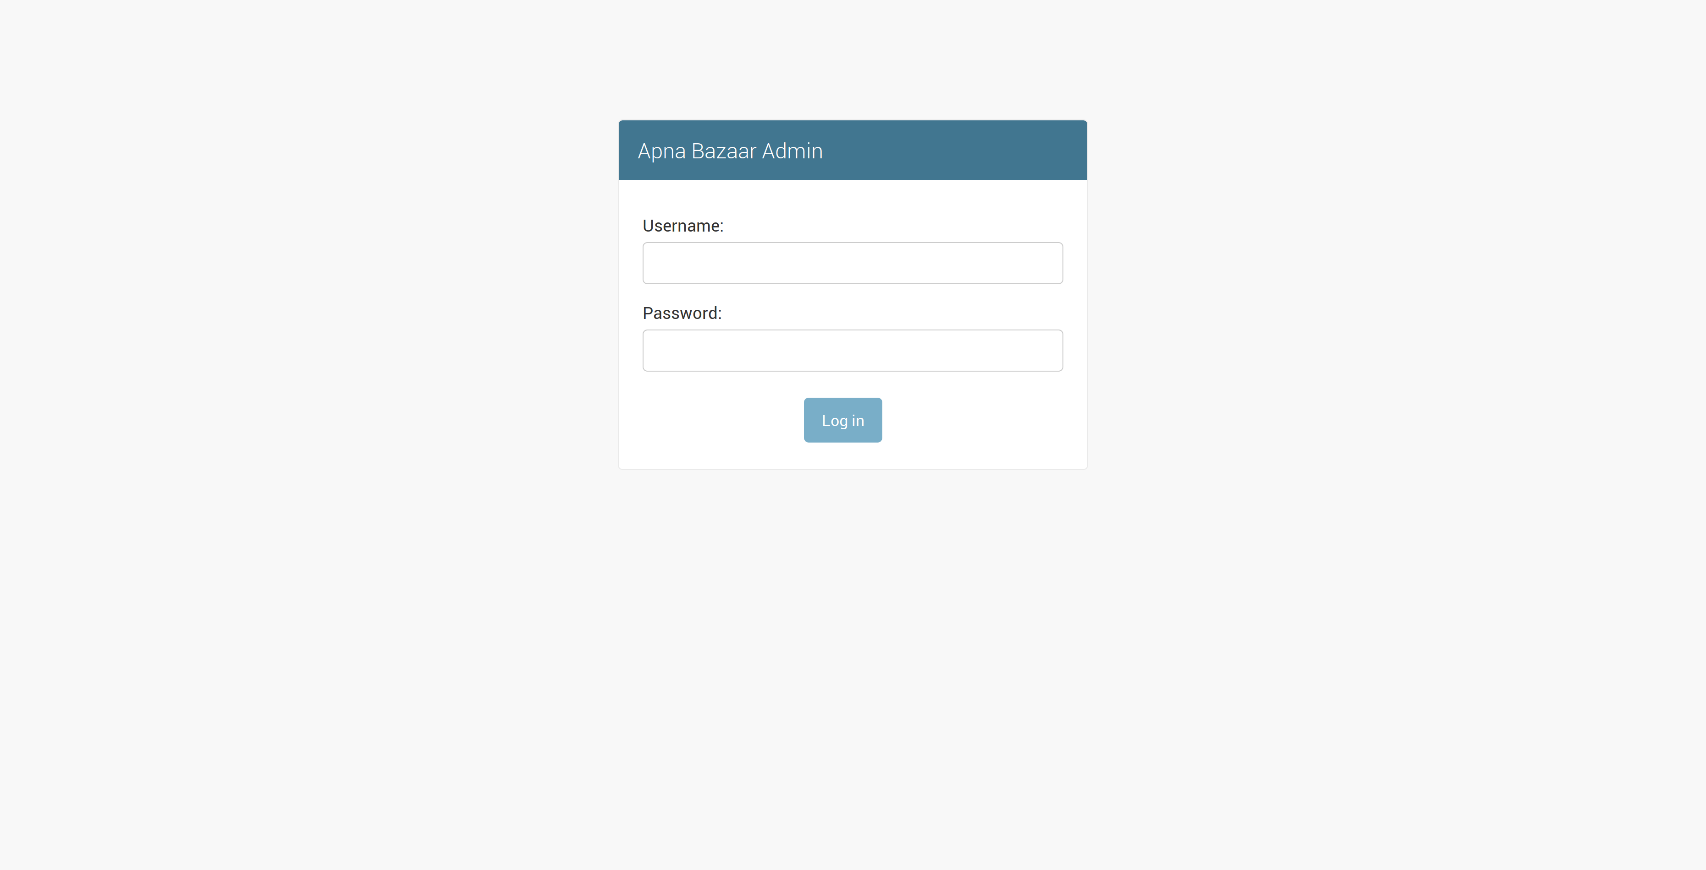

Slide 6
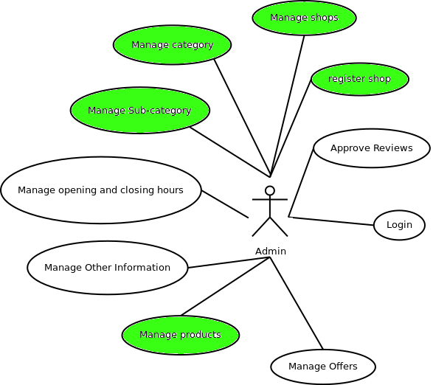
Admin Panel

Slide 7
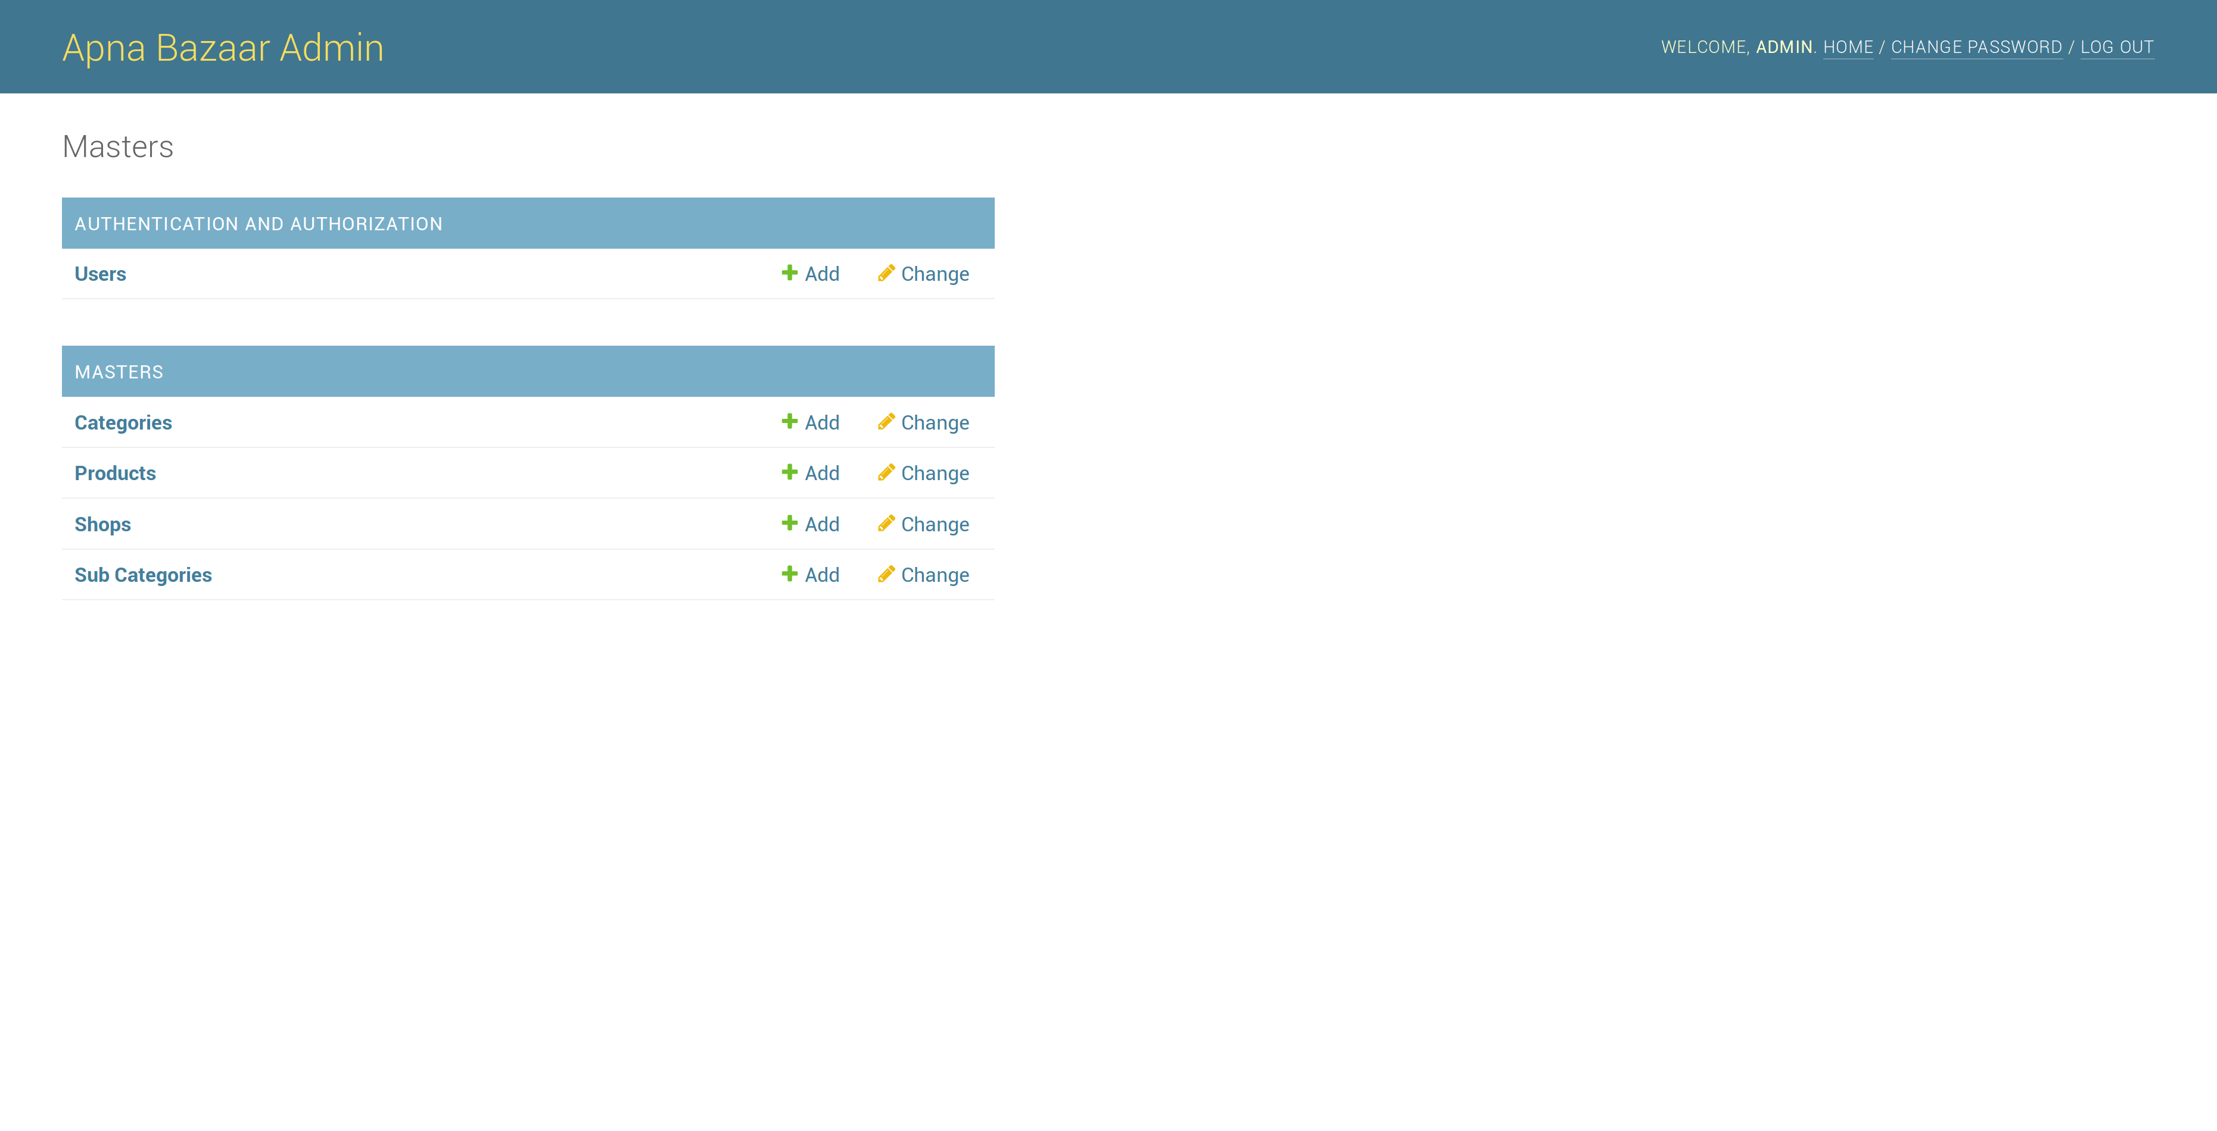

Slide 8
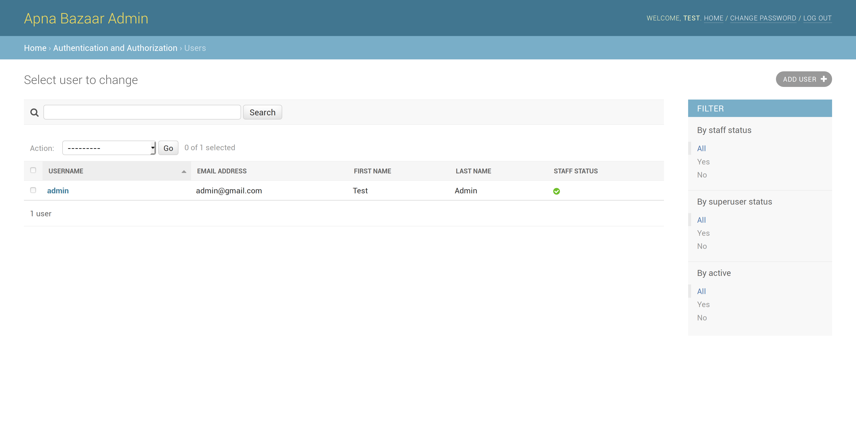

Slide 9
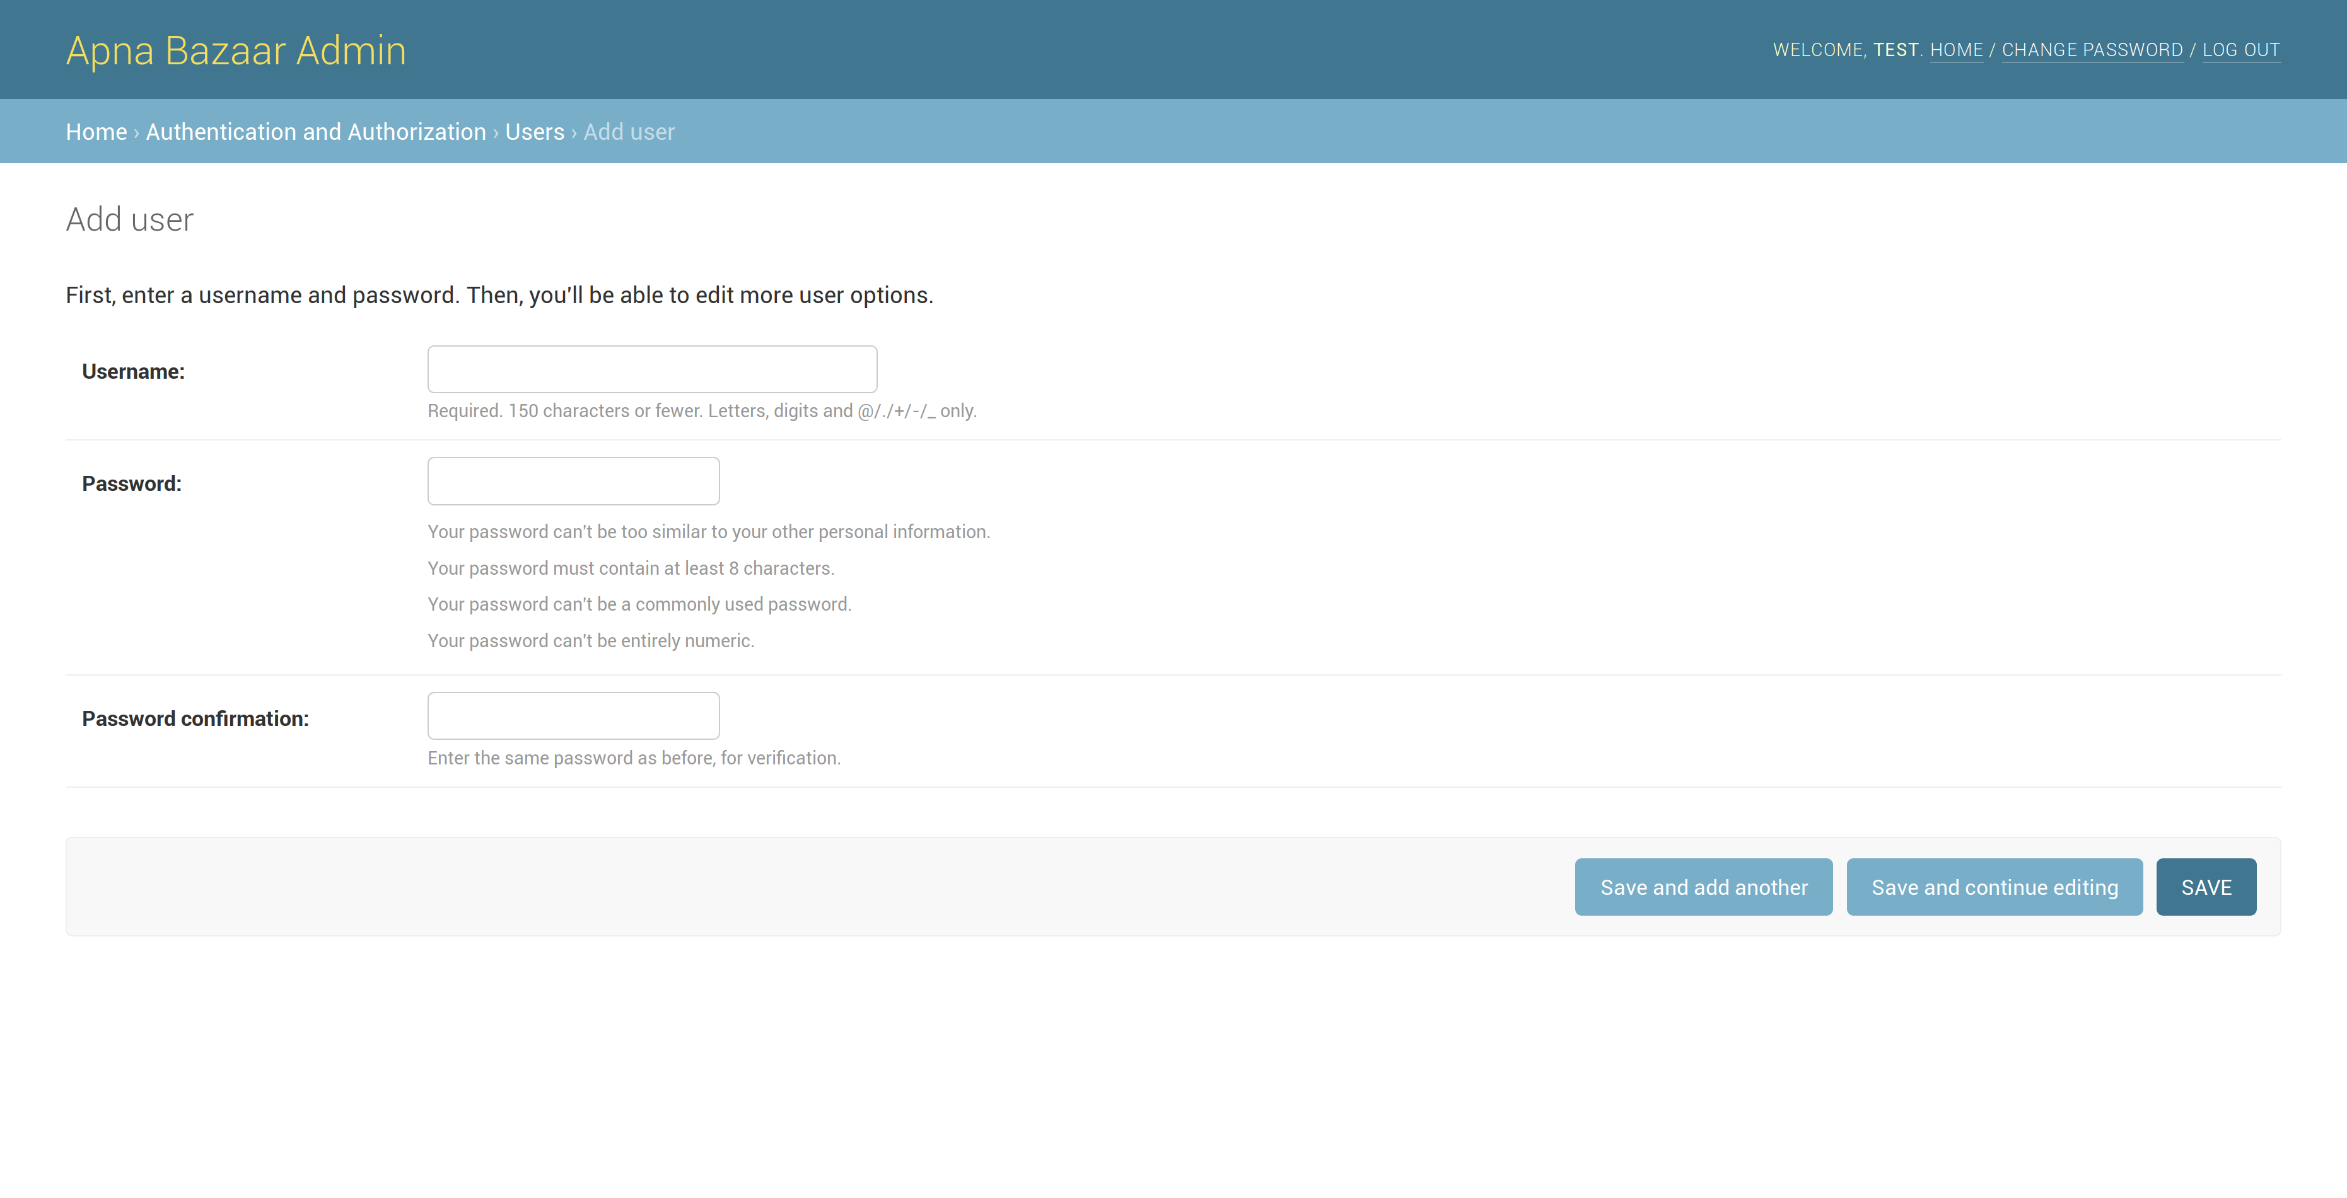

Slide 10
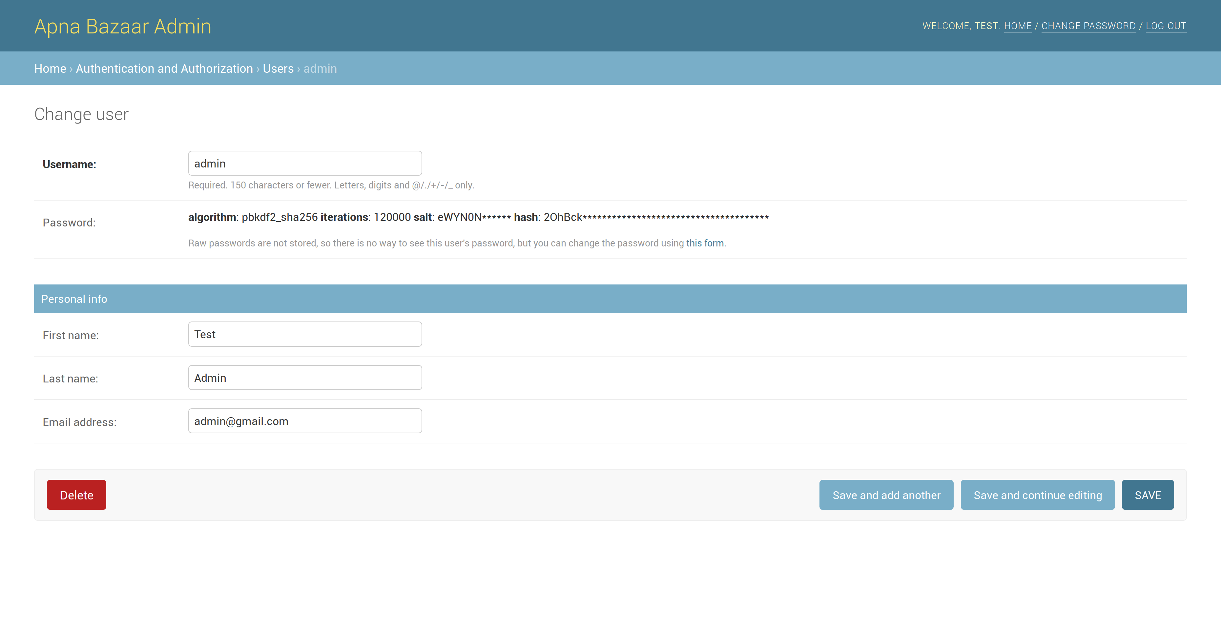

Slide 11
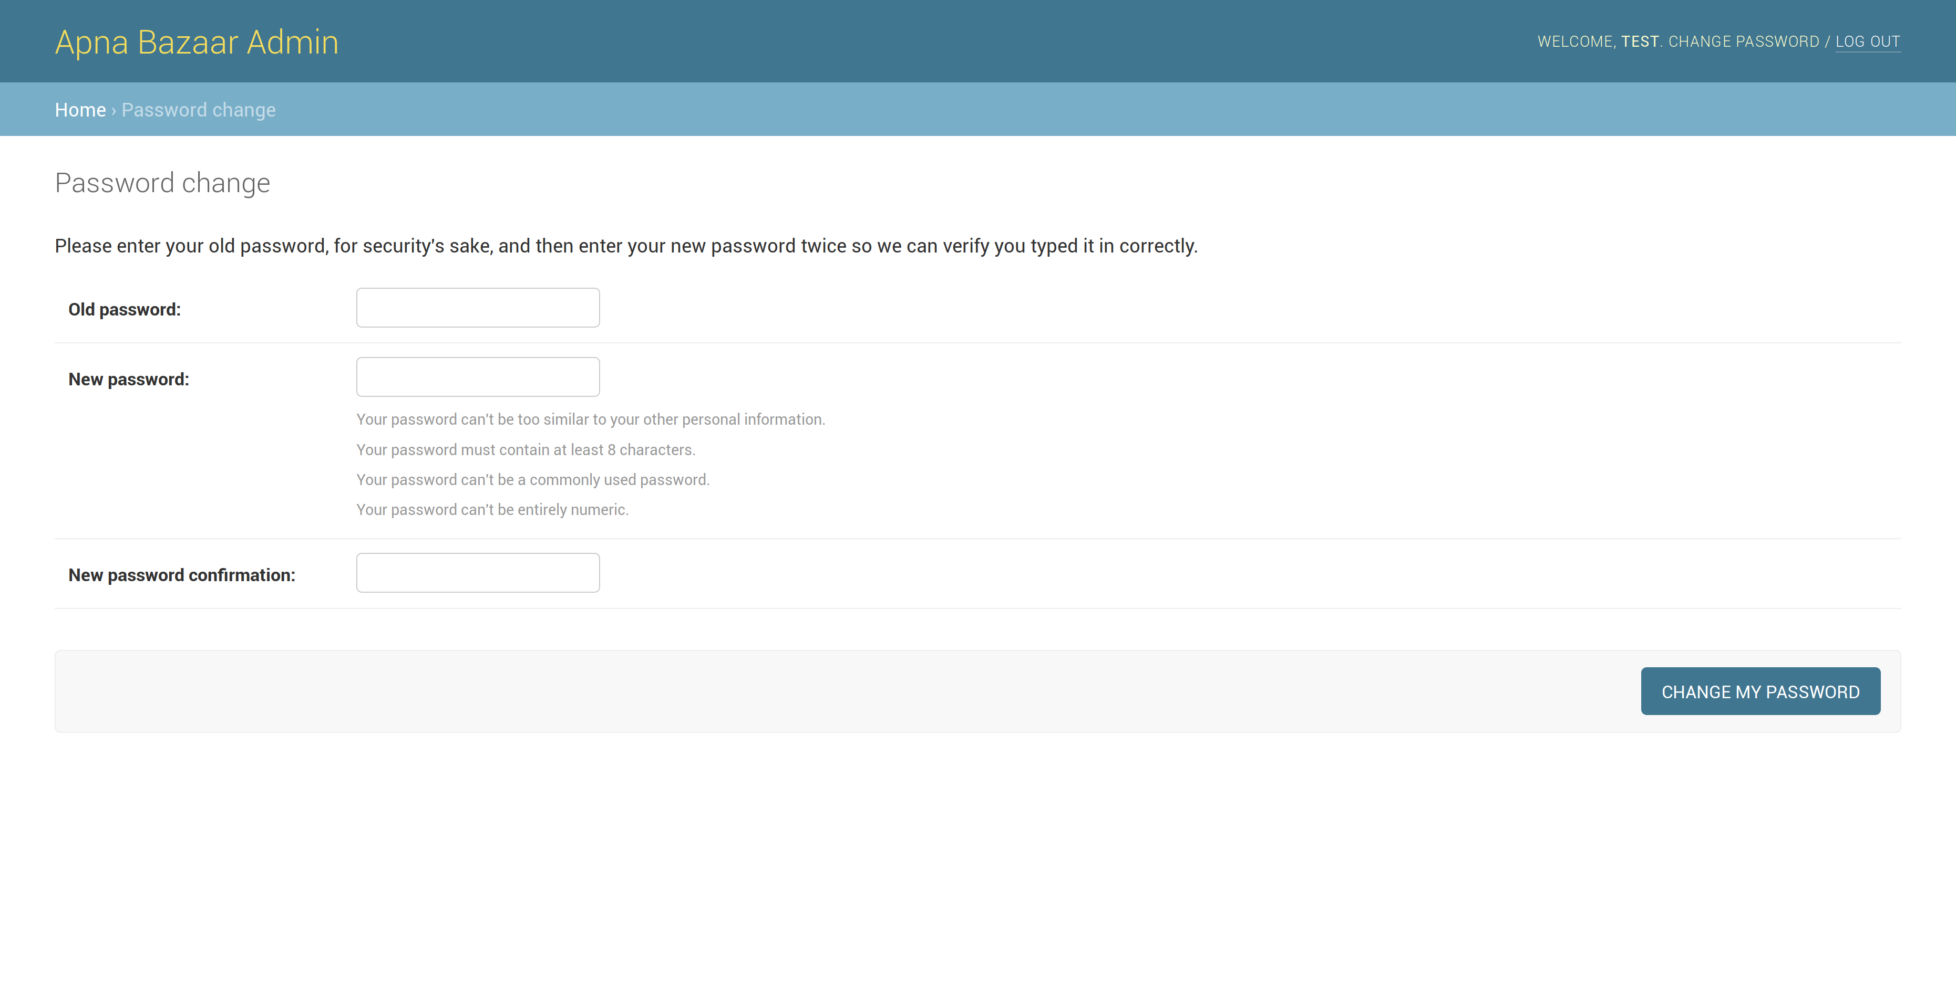

Slide 12
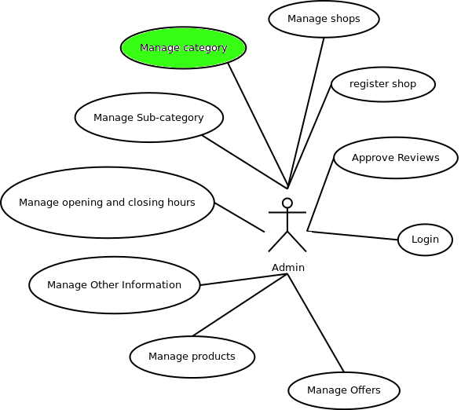
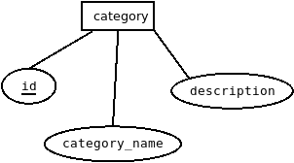
Category
Use Case Diagram
ER Diagram

Slide 13
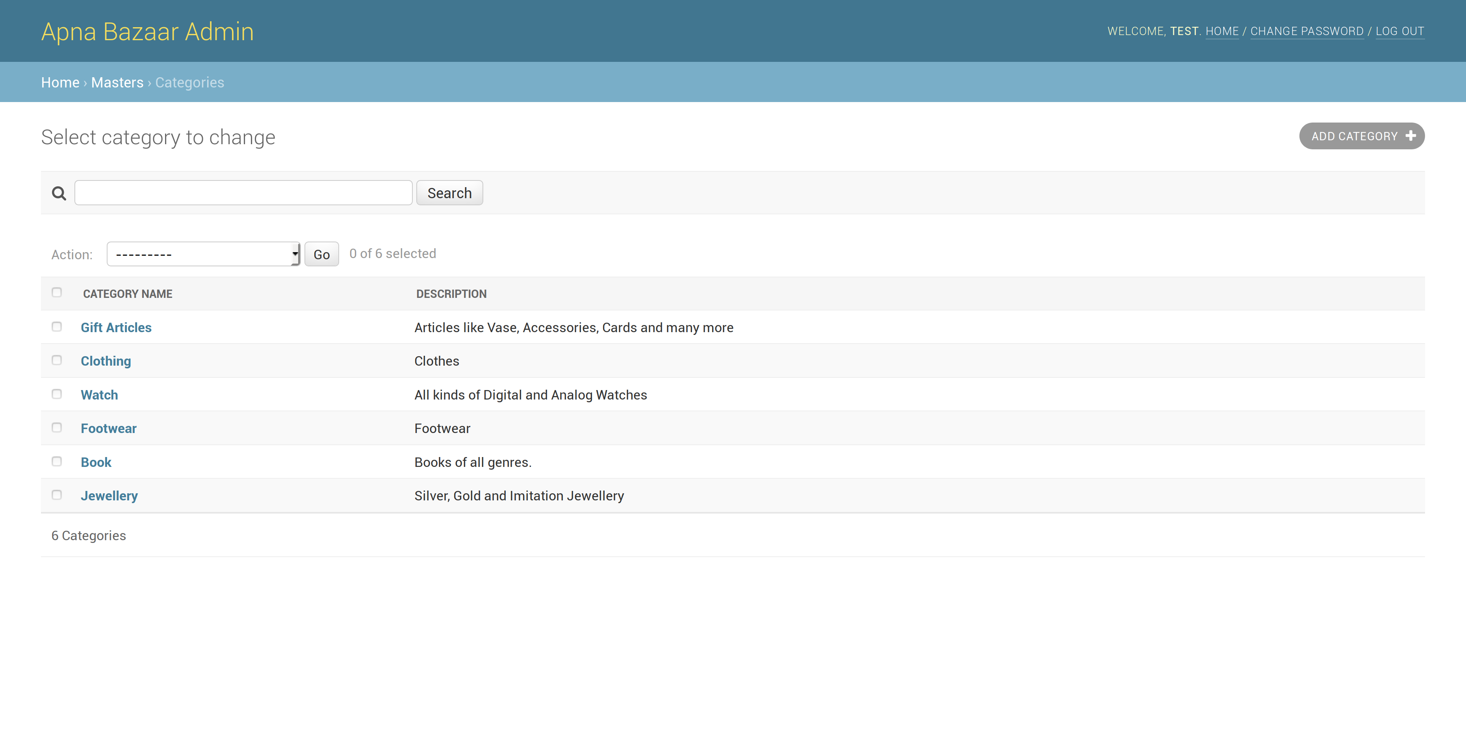

Slide 14
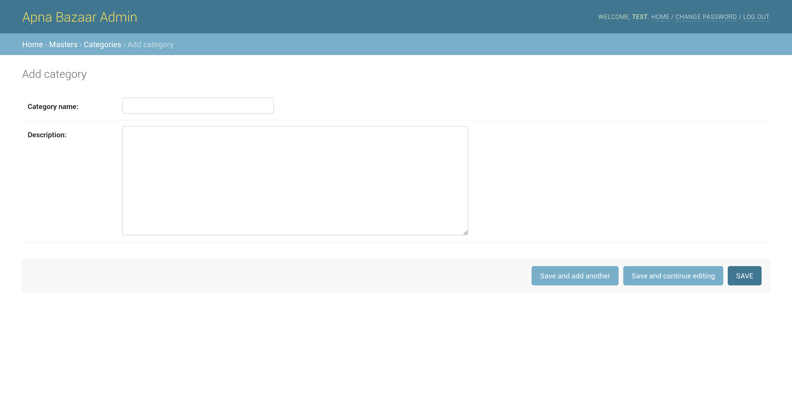

Slide 15
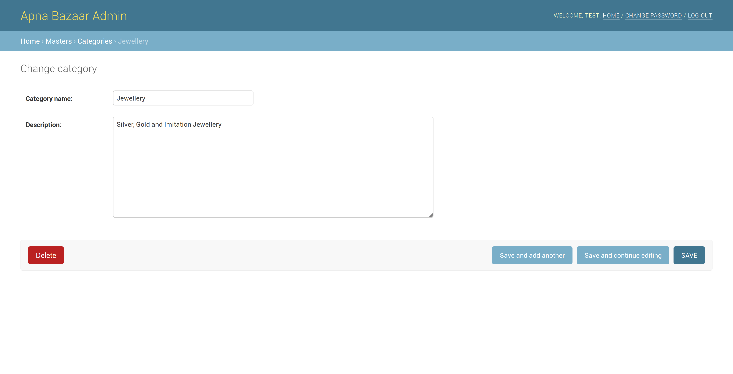

Slide 16
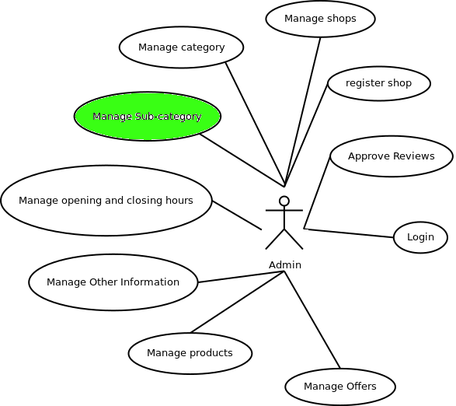
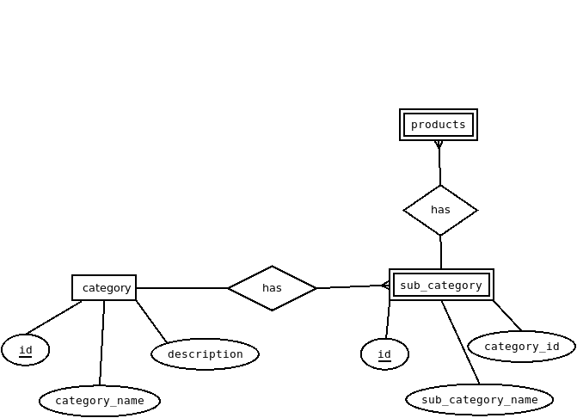
Subcategory
Use Case Diagram
ER Diagram

Slide 17
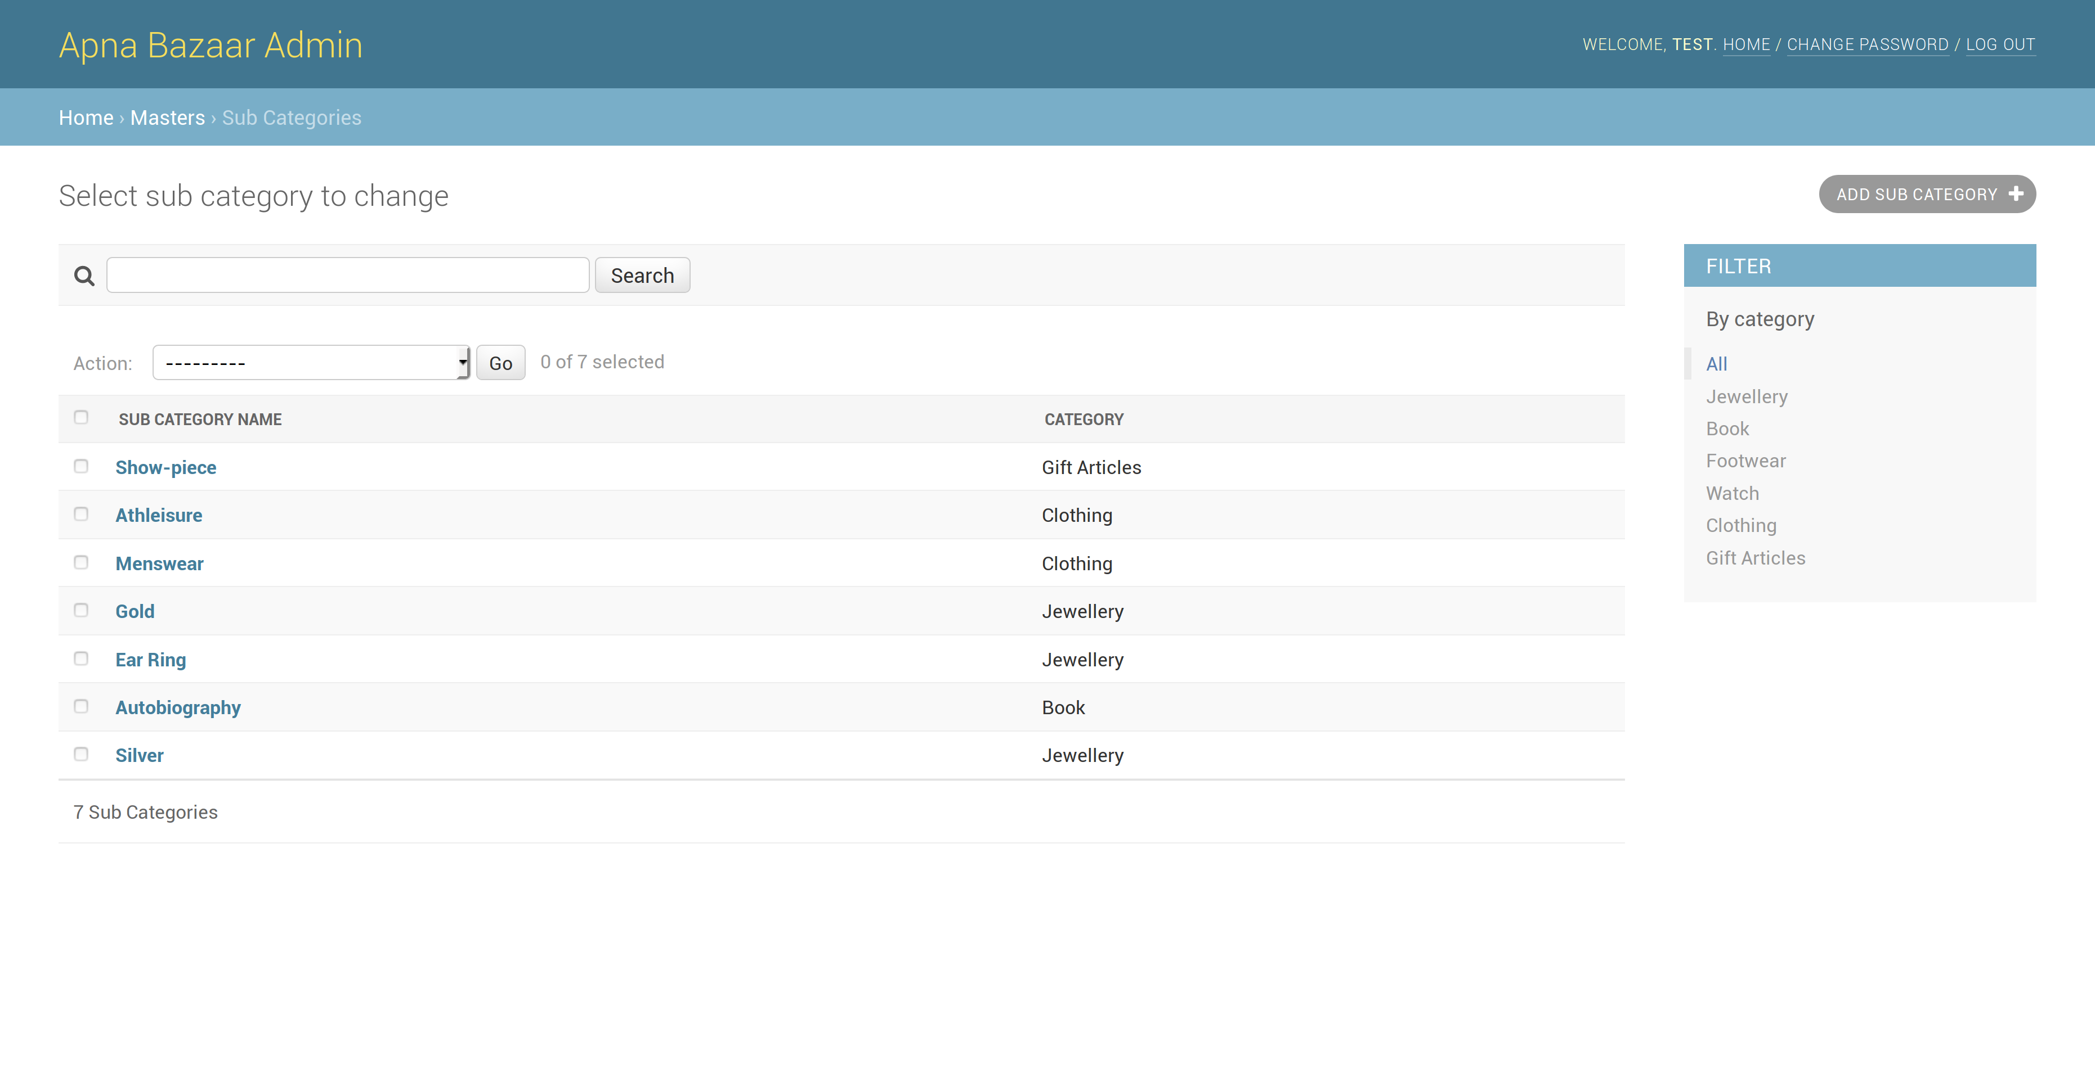

Slide 18
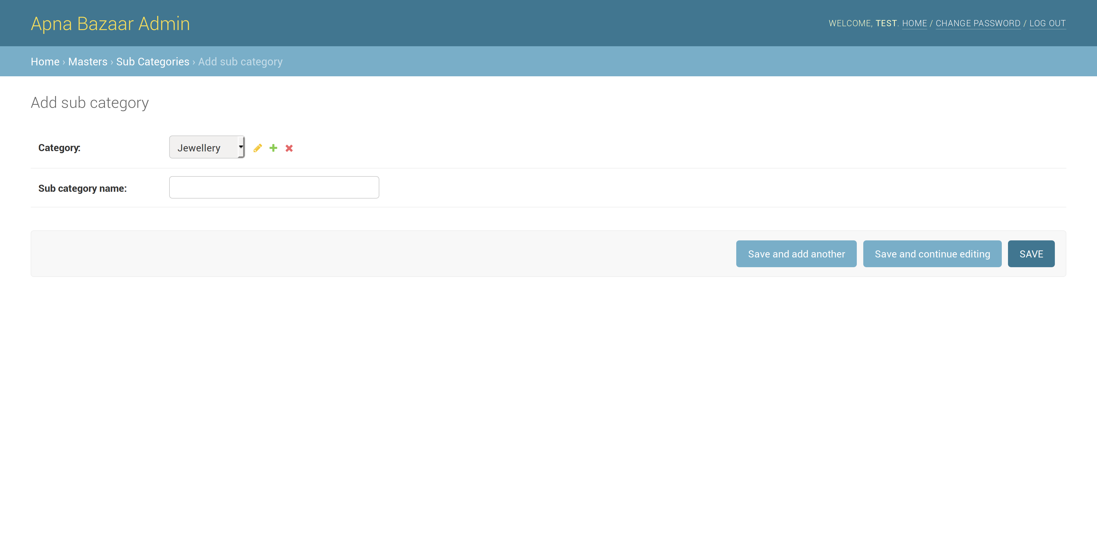

Slide 19
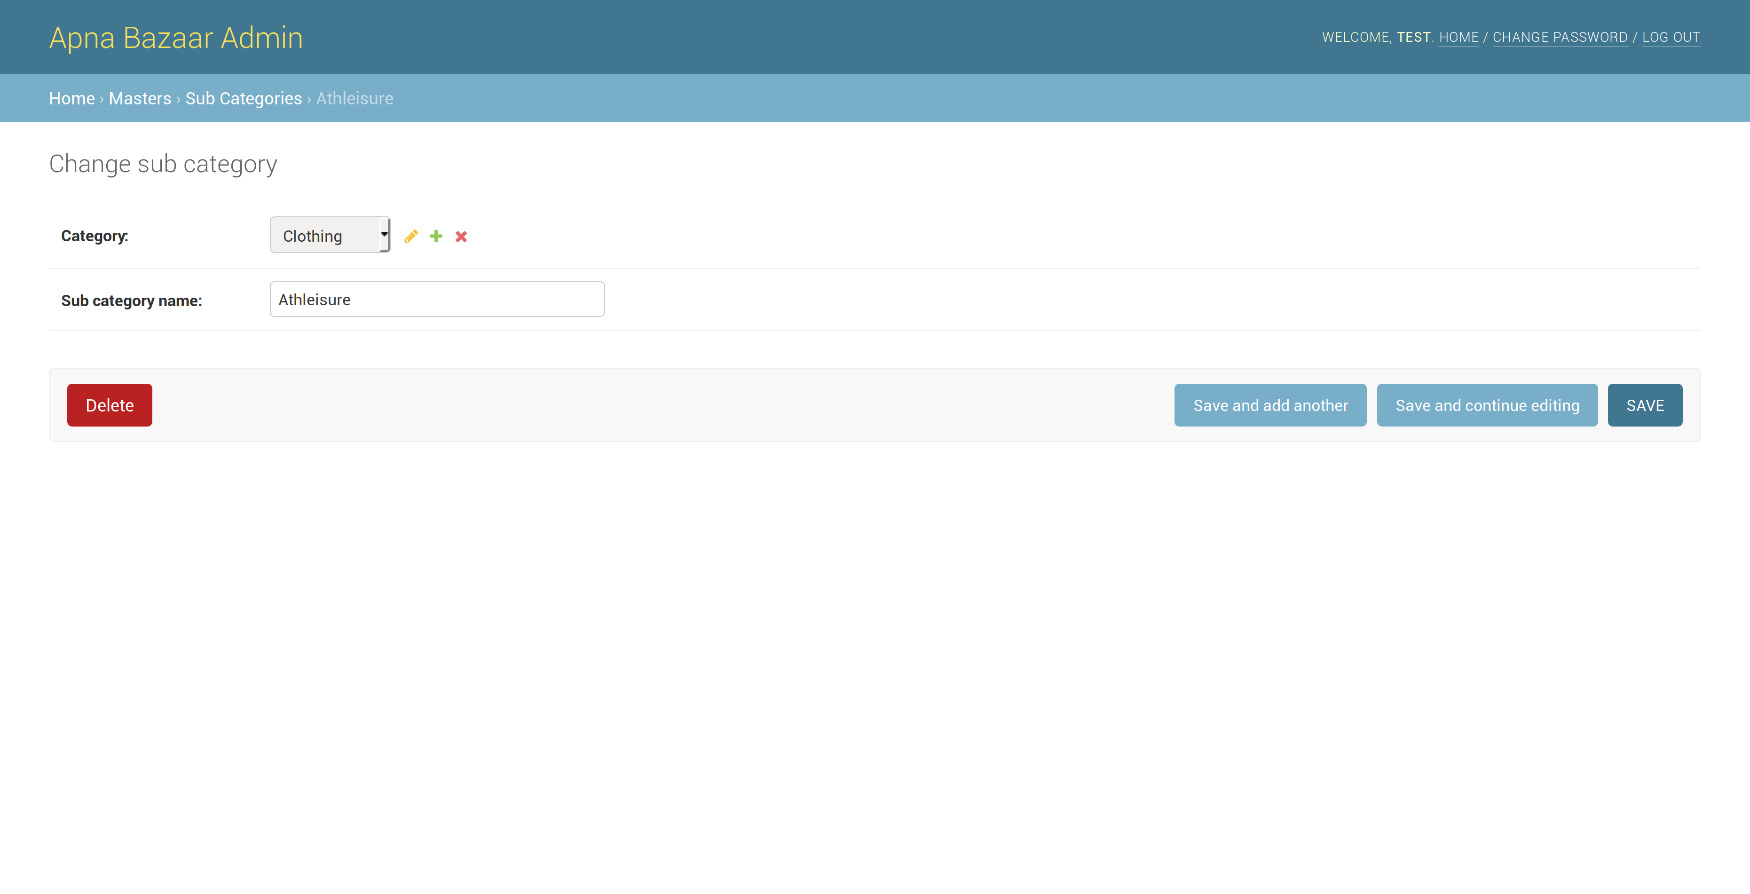

Slide 20
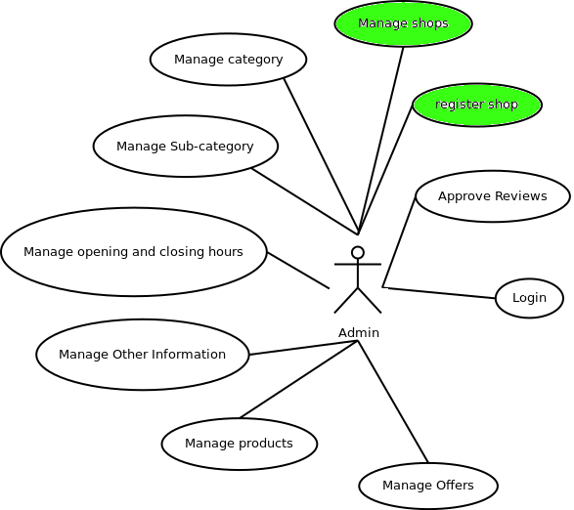
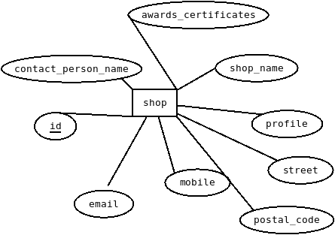
Shop
Use Case Diagram
ER Diagram

Slide 21
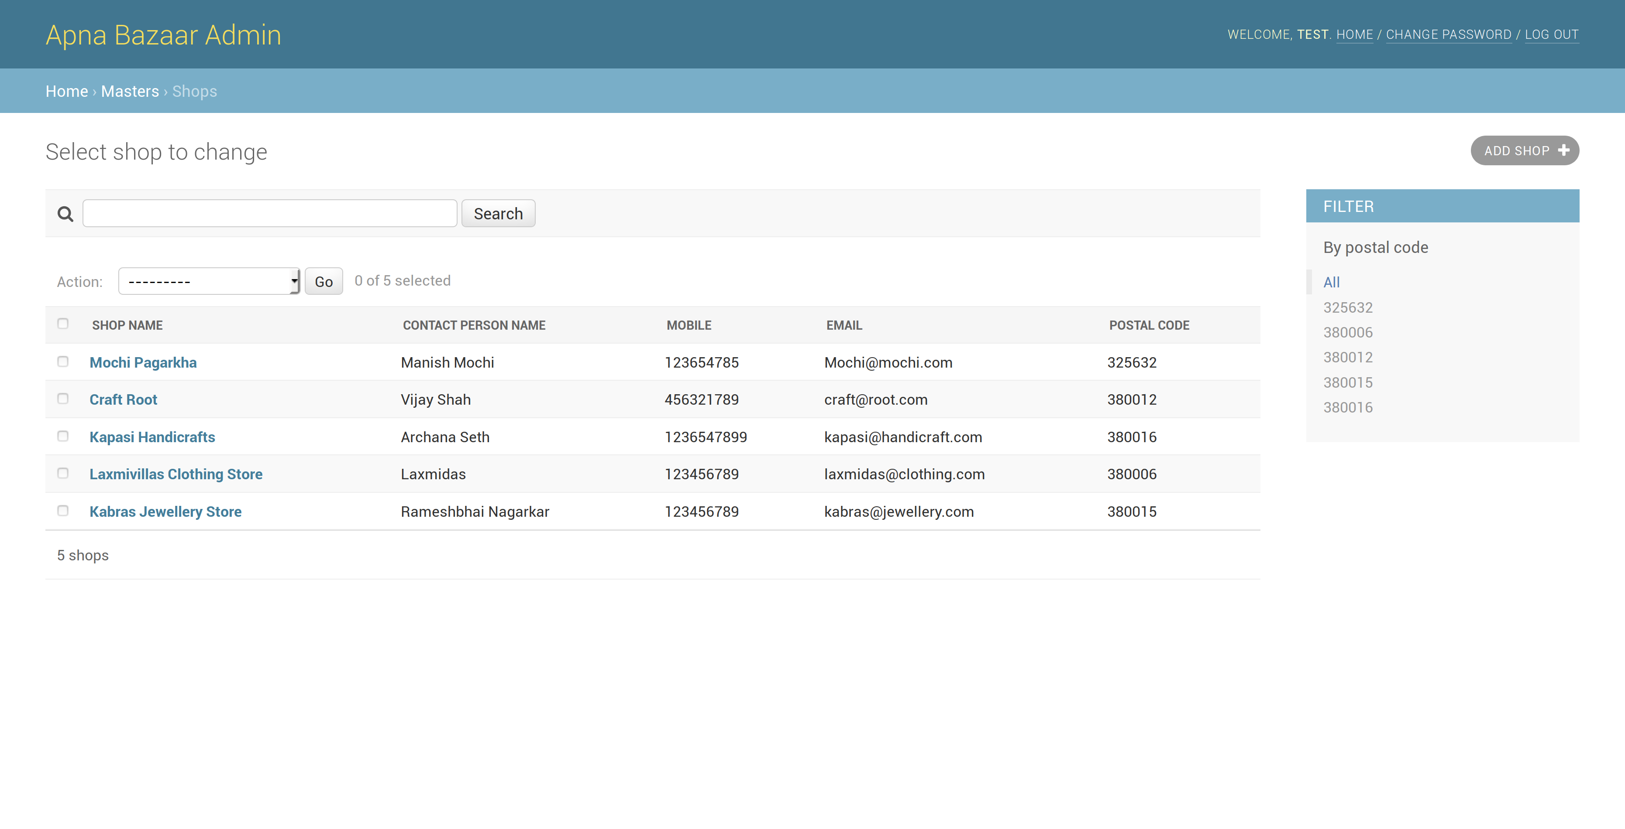

Slide 22
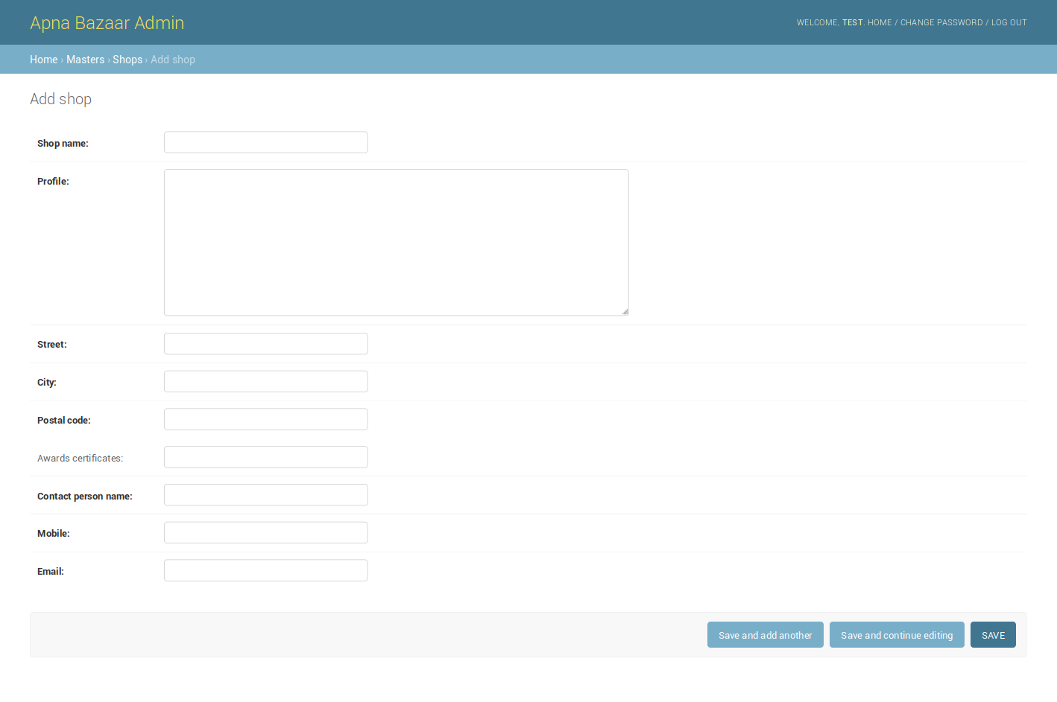

Slide 23
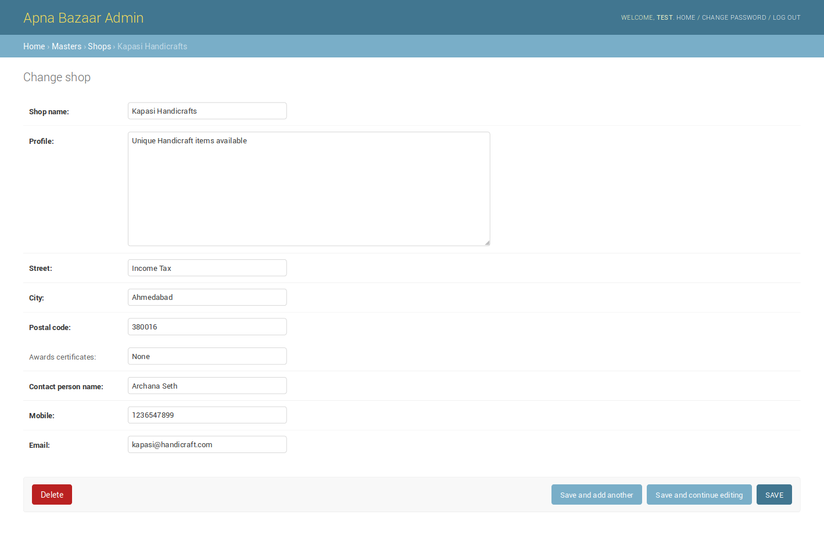

Slide 24
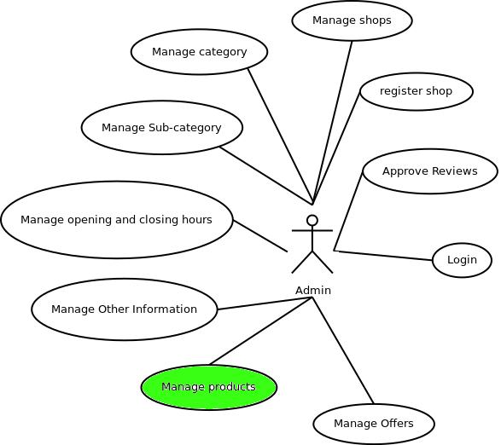
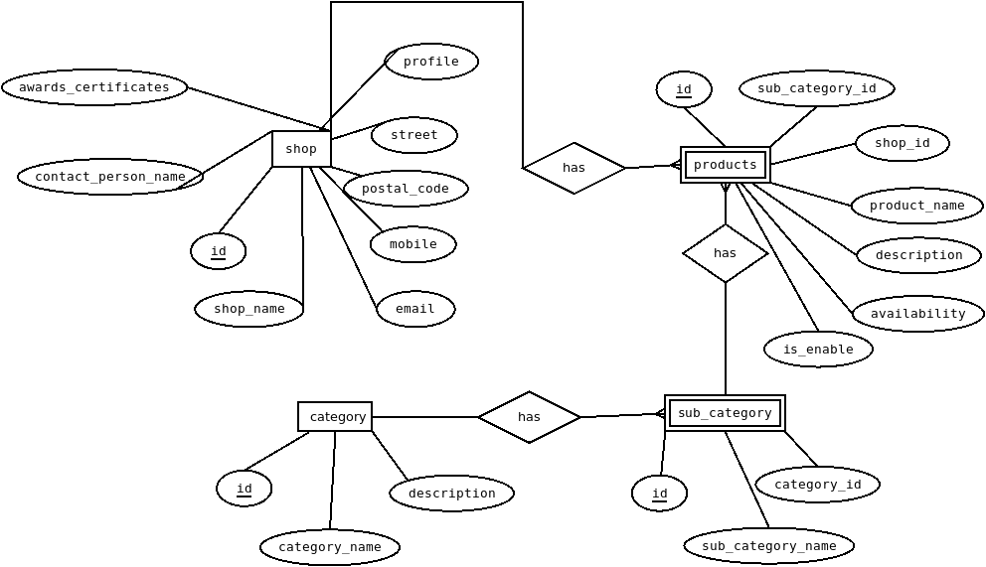
Product
Use Case Diagram
ER Diagram

Slide 25
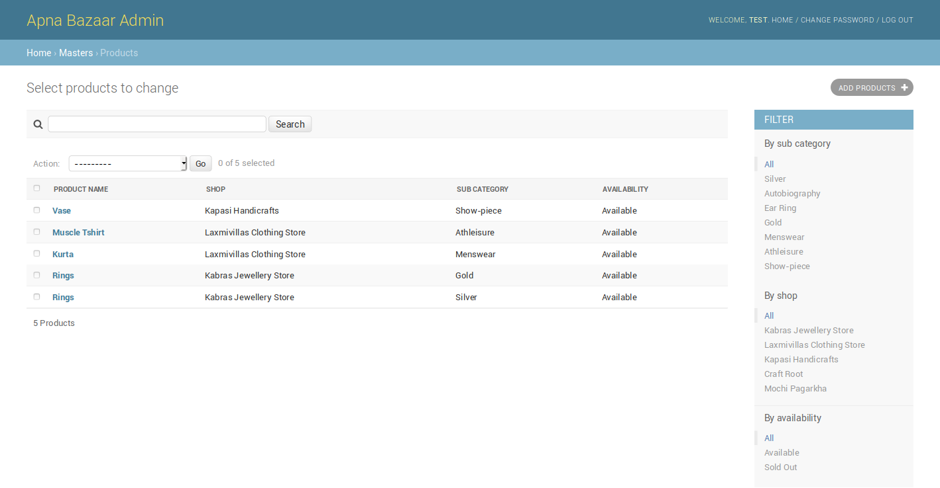

Slide 26
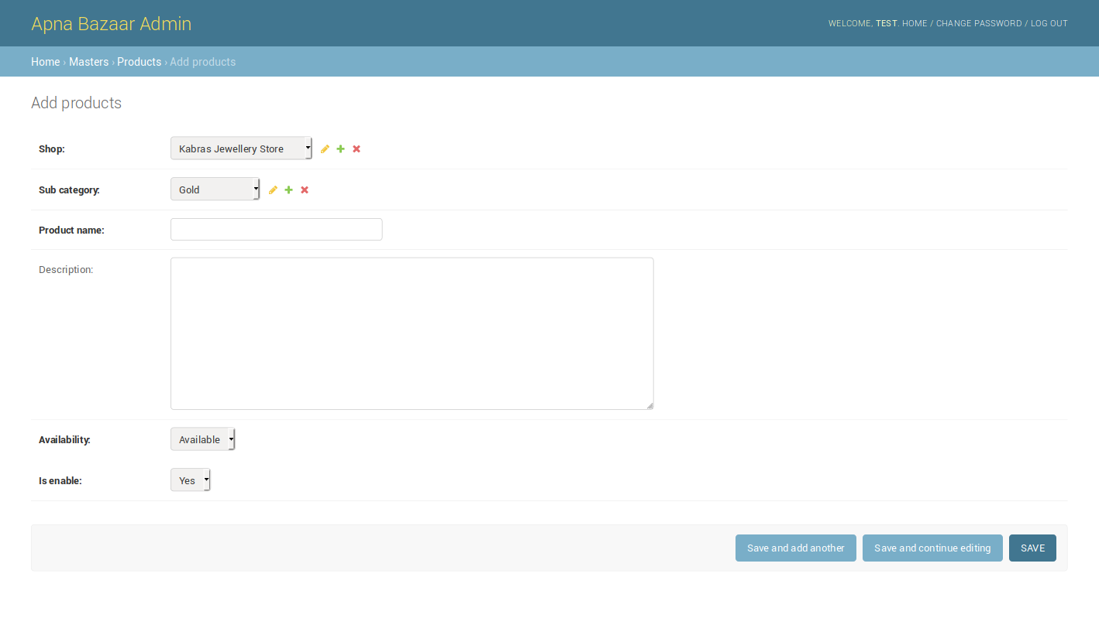

Slide 27
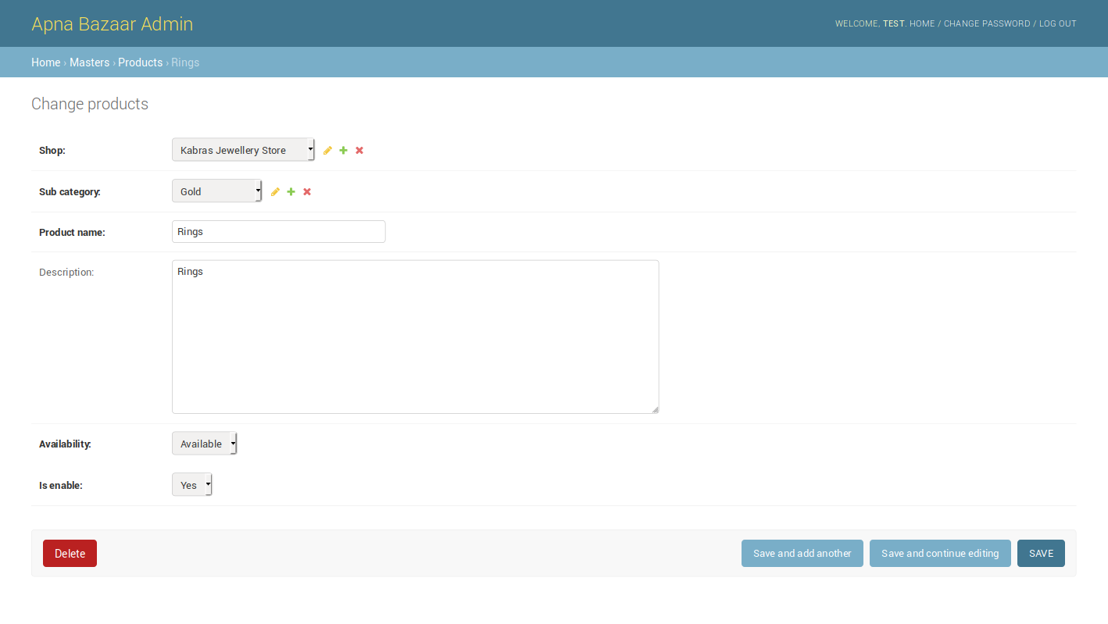

Slide 28
Future Enhancement
Notifications for offers
Map integration
Smart suggest and notify
Give shop control to the shopkeeper
Natural language processing for reviews
Offer suggestion

Slide 29
Conclusion
This web application is aimed for the huge city of Ahmedabad, where there are a lot of markets and abundant shops selling variety of products.
Consumer may not know about all of them but through the medium of this they can have the facility to explore on the basis of products, shops, locations and reviews. This provides exposure to the local shops and its offers and at the same time users can have their pick from a variety.

